Slide 1
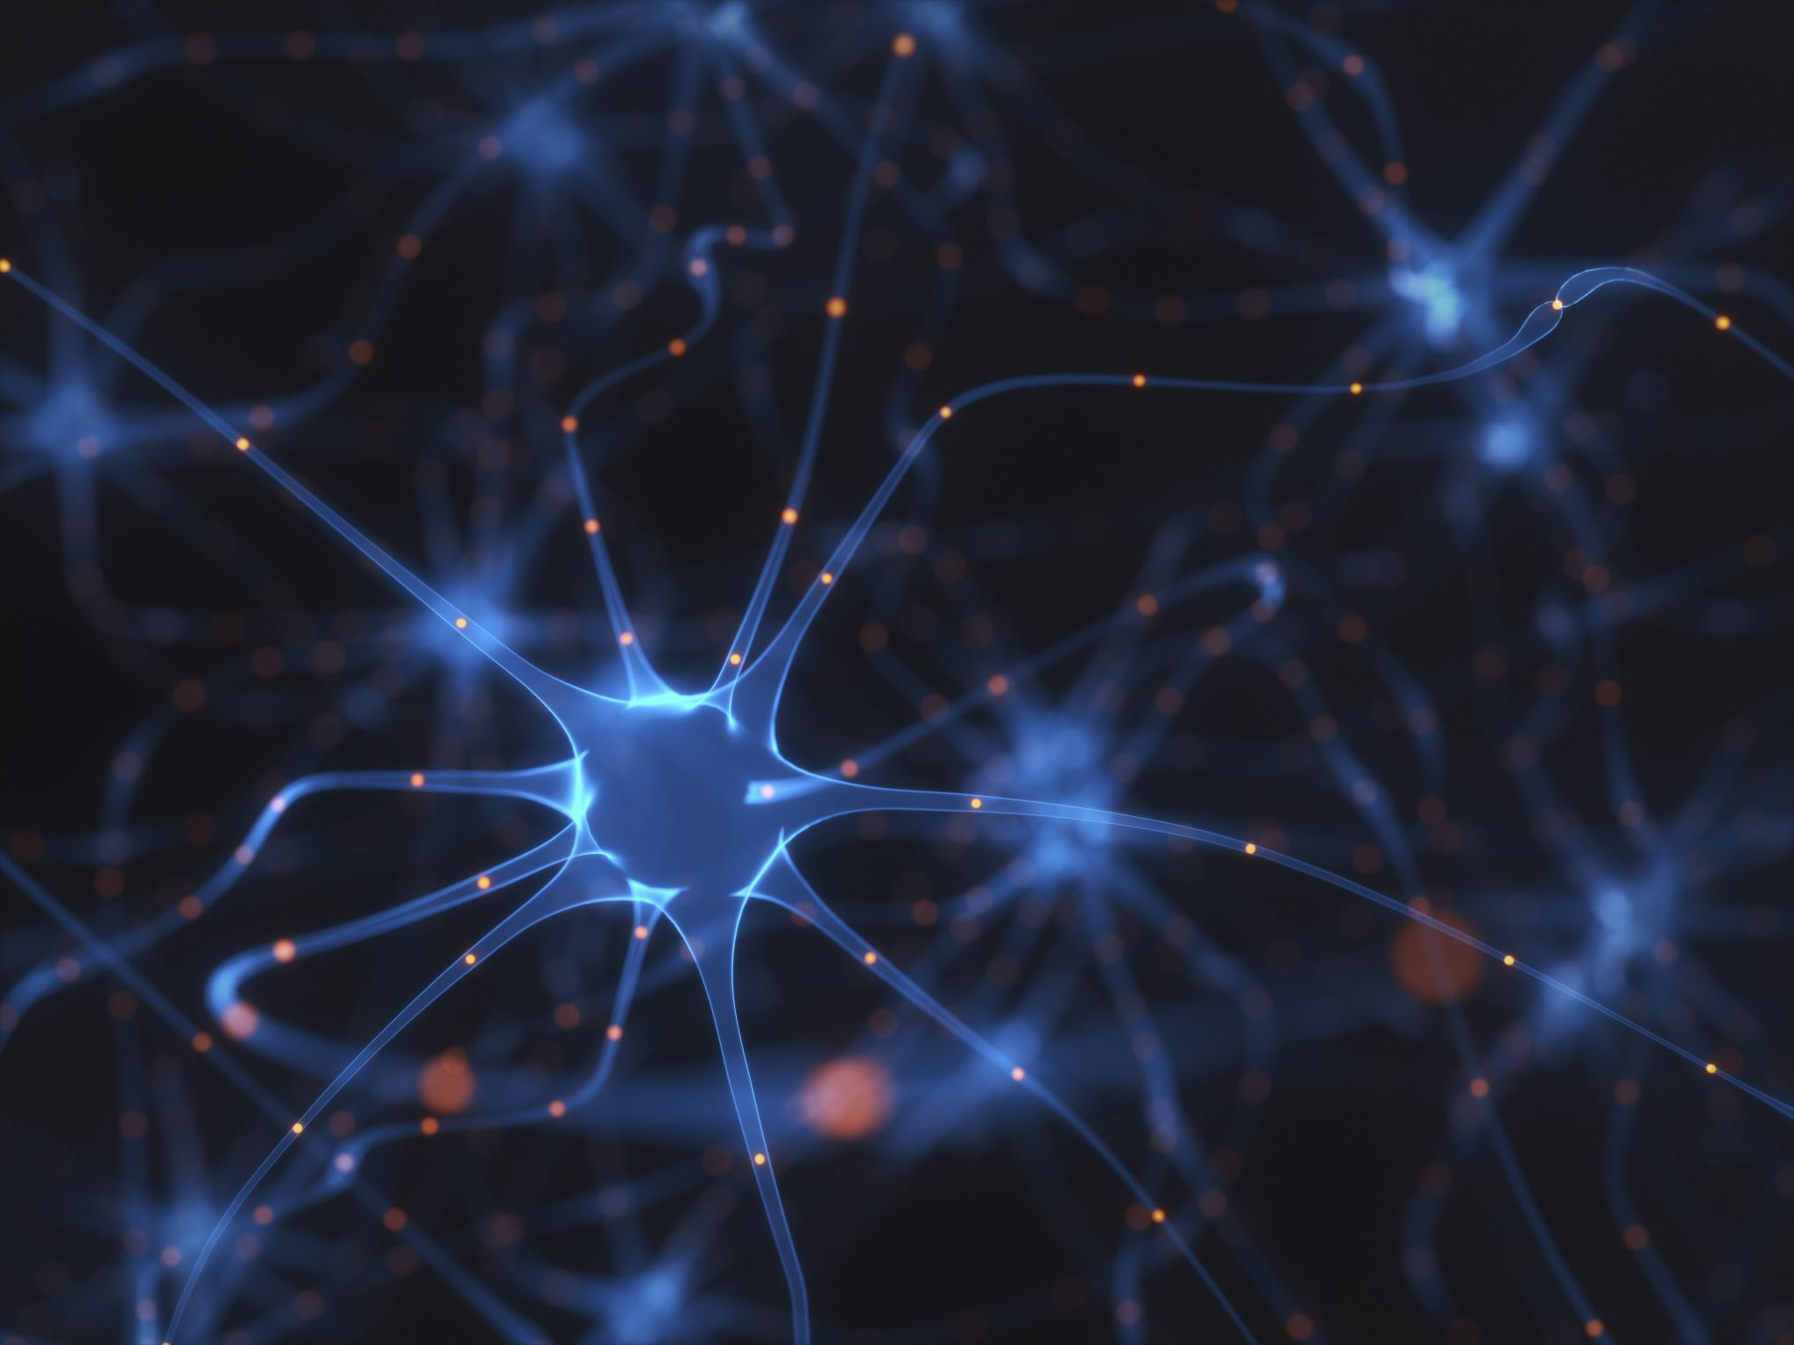
Disease detection using DCNN
Rahul Khanna Majd Noel Pratik Bhanuse

Slide 2
Agenda
Medicinal Applications of Neural Network
Heart Disease Detection
Model Architecture (BMK – Architecture)
Results
Brain Tumor Detection
Results and Discussion

Slide 3

The paper
https://pmc.ncbi.nlm.nih.gov/articles/PMC9687844/#sec3-biomedicines-10-02796

Slide 4
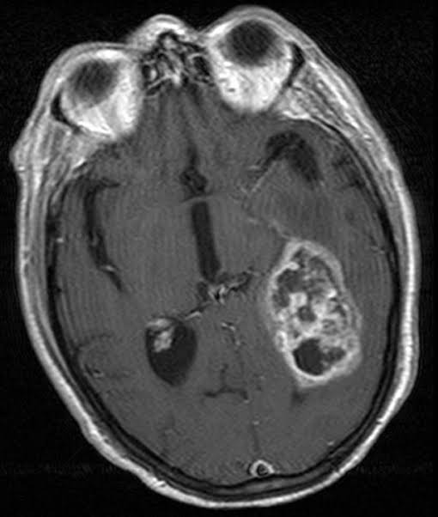
Importance of ML in Healthcare
Tumors, Cancer and Heart diseases are one of the key contributors for human death.
The diagnoses comes from image viewing and classifications
Images gets trained on a ML model and then the model predicts the diagnoses of these images.
https://www.kaggle.com/datasets/sartajbhuvaji/brain-tumor-classification-mri

Slide 5
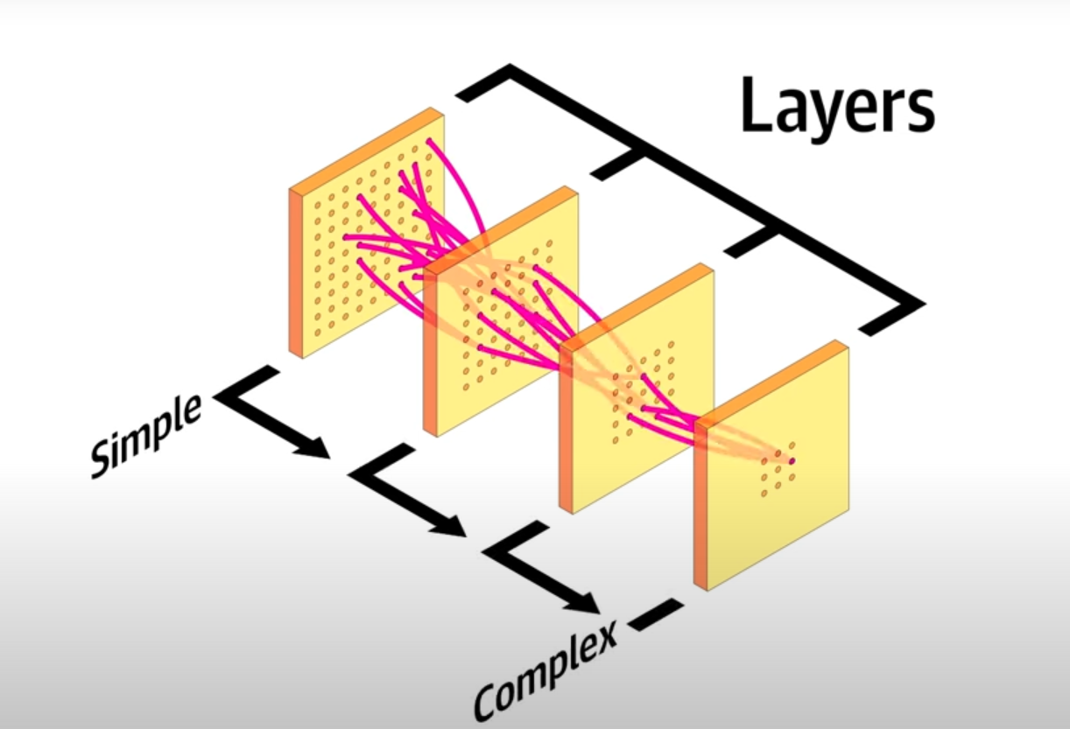
Deep Convolutional Neural Network
Deep Convolutional Neural network (DCNN) have been used in the previous years for detection.
DCNN is a method that uses multi-layers to classify the data or image.
A layer input receives the output from the previous layer to filter it in a way and outputs it to the next one
https://www.youtube.com/watch?v=VKnoyiNxflk&t=329s

Slide 6
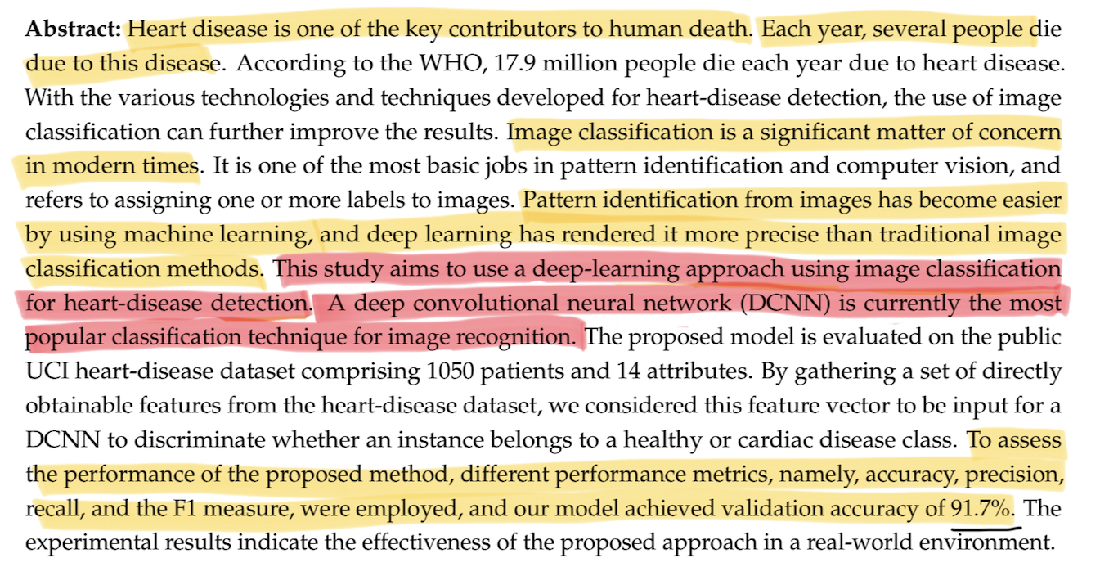
Deep Convolutional Neural Network

Slide 7
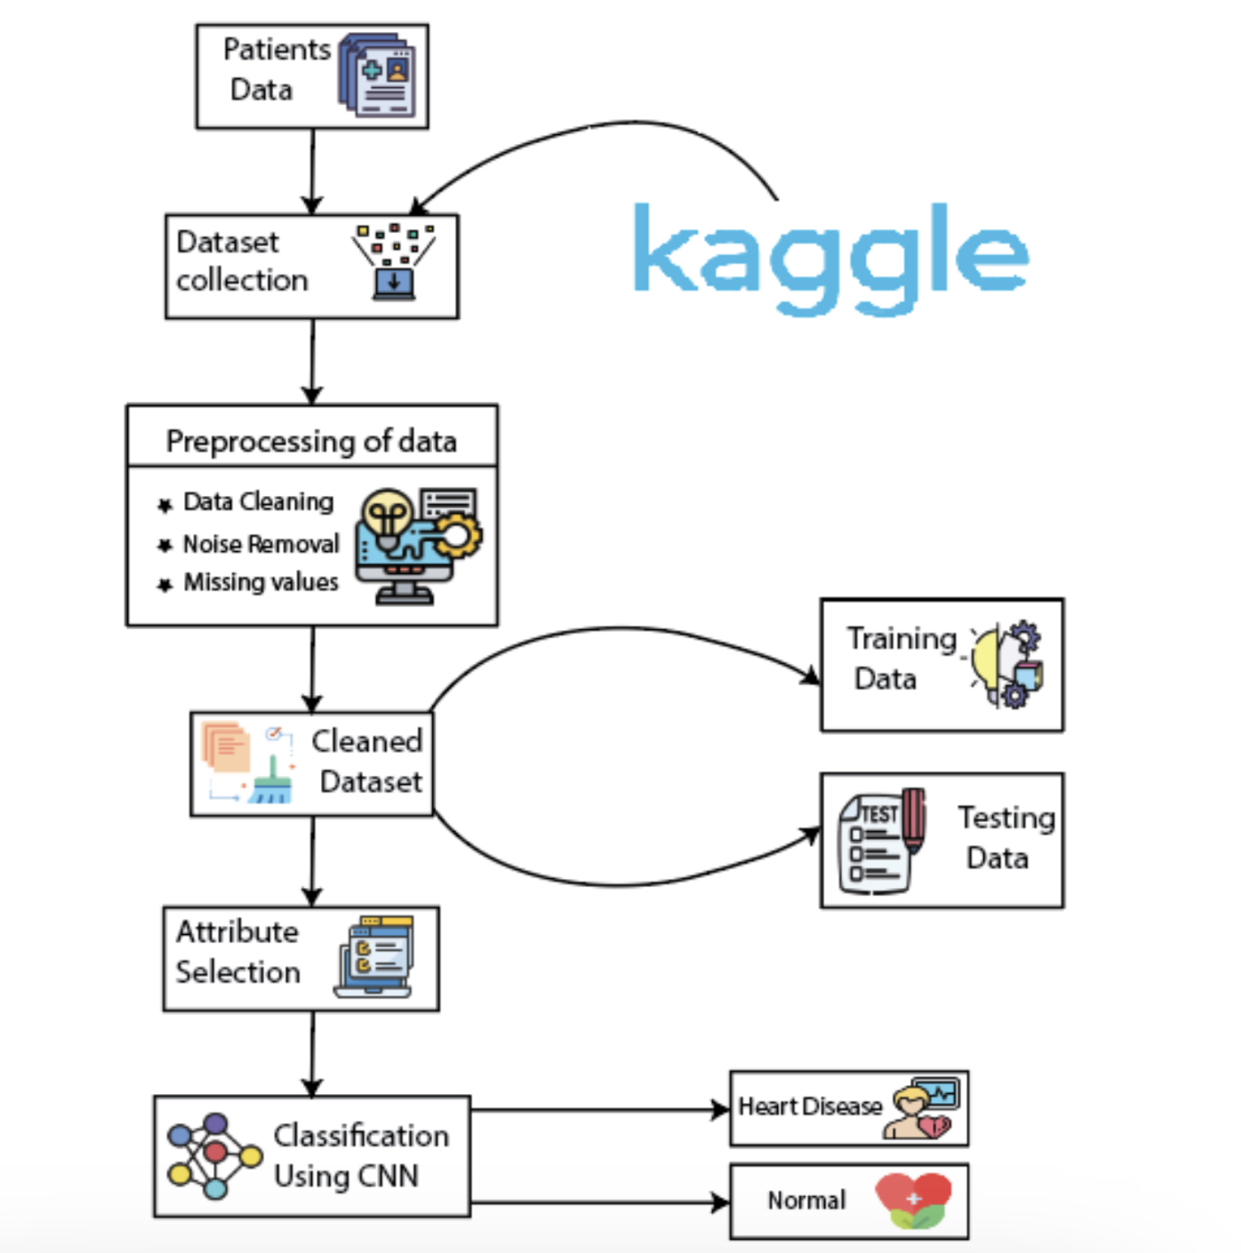
Process
Data collection of patients (1050 patients, which included 76 attributes. The 14 most relevant attributes was used for the model )
Missing values were filled in or removed from the data
80% percent of the data was used for training the DCNN algorithm and the 20% was used for testing the model.
​DCNN algorithm output the result

Slide 8
Heart disease detection
Sr No. | Attributes | Representation | Description | Type
1 | Age | age | Age in years | Integer
2 | Gender | sex | Male and female | Binary(1 for male and 0 for female)
3 | Chest pain | cp | Four types of chest pain | Categorical
4 | Cholesterol level | Chol | Measure of cholesterol in mg/dl | Integer
5 | Resting blood pressure | trestbps | Blood pressure when the body is in a state of rest | Integer
6 | Fasting blood sugar | fbs | Blood sugar level while fasting | Binary (1 for true and 0 for false)
7 | MaxHR | thalach | Maximal heart rate | Integer
8 | Rest ECG | restecg | Resting electrocardiograph | categorical
9 | Exercise-induced angina | exang | Exercise-induced angina | Binary (1 for yes and 0 for no)
10 | Old peak | oldpeak | ST depression brought by exercise comparative to rest | Continuous
11 | Slope | slope | Slope of exercise peak | Discrete
12 | Vessels | ca | No. of major vessels | Continuous
13 | Thalassemia | thal | Normal, fixed, and reversible defects | discrete
14 | Heart disease | target | Predicted attribute | Binary

Slide 9
Calculations
Accuracy: ratio of the correct precision to the total precisions
Accuracy=TP/(TP+TN+FN+FP)
Precision: ratio of the correct predictions to the total number of inputs
Precision=TP/(TP+FP)
Recall: ratio of correct class prediction to the total number of inputs of the class
Recall=TP/(TP+FN)
F1-Score: The combination of precession and recall
F1-Score = 2 * (Precision * Recall)/(Precision + Recall)

Slide 10
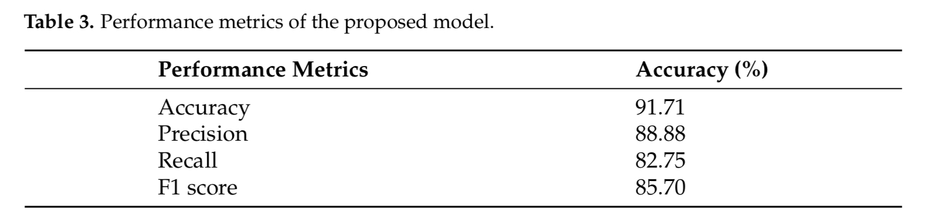
Results of the paper
 | Model V1 | Model V2
Accuracy | 75.00% | 81.67%
Precision | 76.80% | 82.76%
Recall | 75.00% | 81.67%
F1 Score | 74.85% | 81.64%

Slide 11
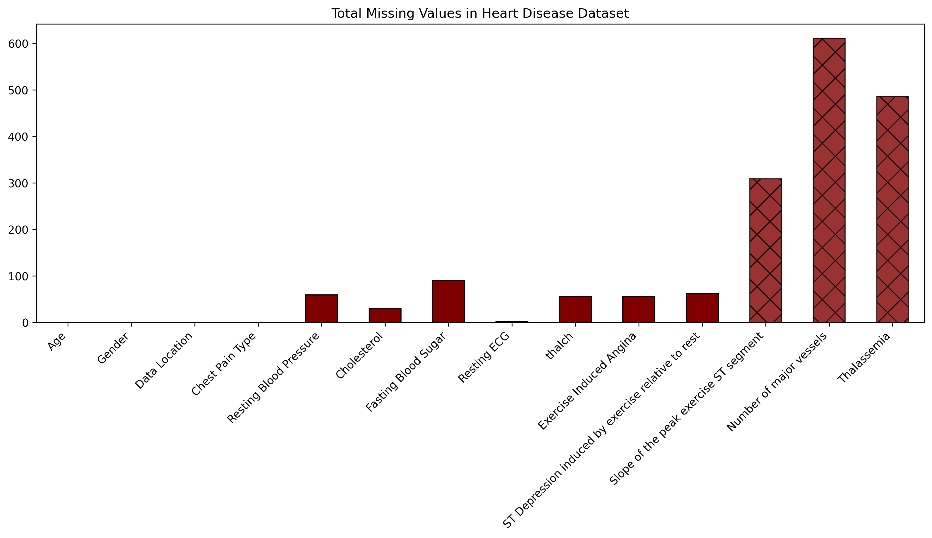
Data Abnormality

Slide 12
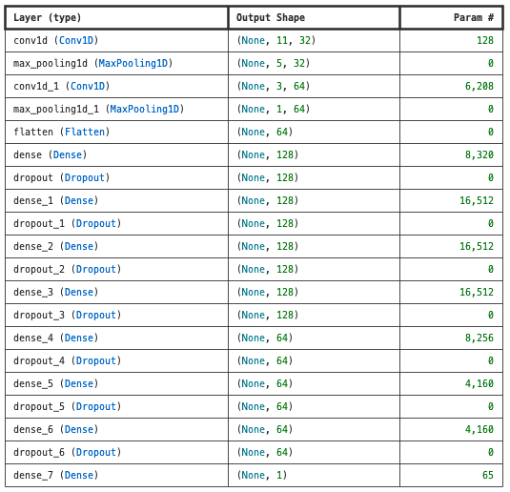
Model Architecture
Model V1
2 – 1D-Convolutional Neural Networks
8: Dense Layer
4 layers – 128 Neurons
3 layers – 64 Neurons
1 layer – 1 Neuron
Activation function: Exponential Linear Unit (ELU)
Optimiser: Nadam
Loss Function: Binary Cross-Entropy
Learning Rate: 0.001
Dropout Rate: 3%
Train – Test Split: 80% : 20%

Slide 13
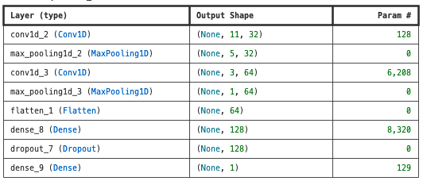
BMK – Architecture
Model V2 – BMK Architecture
2 – 1D-Convolutional Neural Networks
2 Dense Layer
1 layer – 128 Neurons
1 layer – 1 Neuron
Activation function: Rectified Linear Unit (ReLU)
Optimiser: Adam
Loss Function: Mean Squared Error
Learning Rate: 0.001
Dropout Rate: 5%
Train – Test Split: 80% : 20%

Slide 14
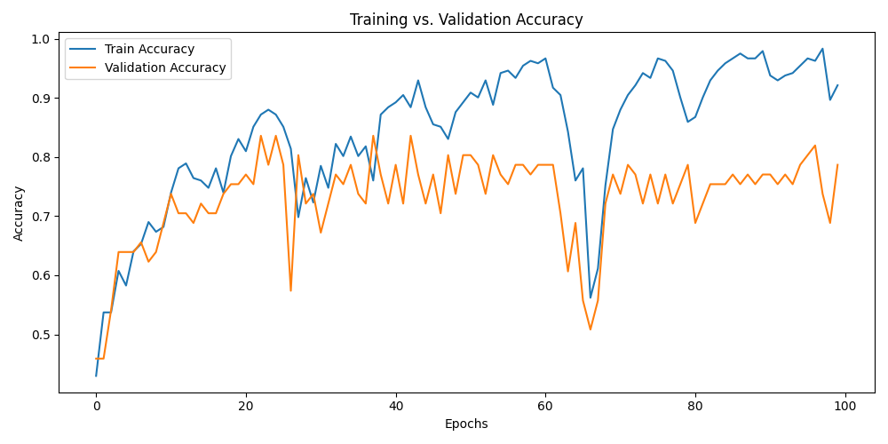
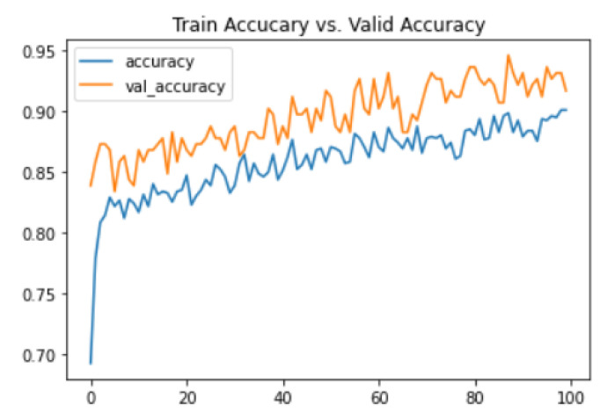
Accuracy Curve (Author’s approach)
10.3390/biomedicines10112796

Slide 15
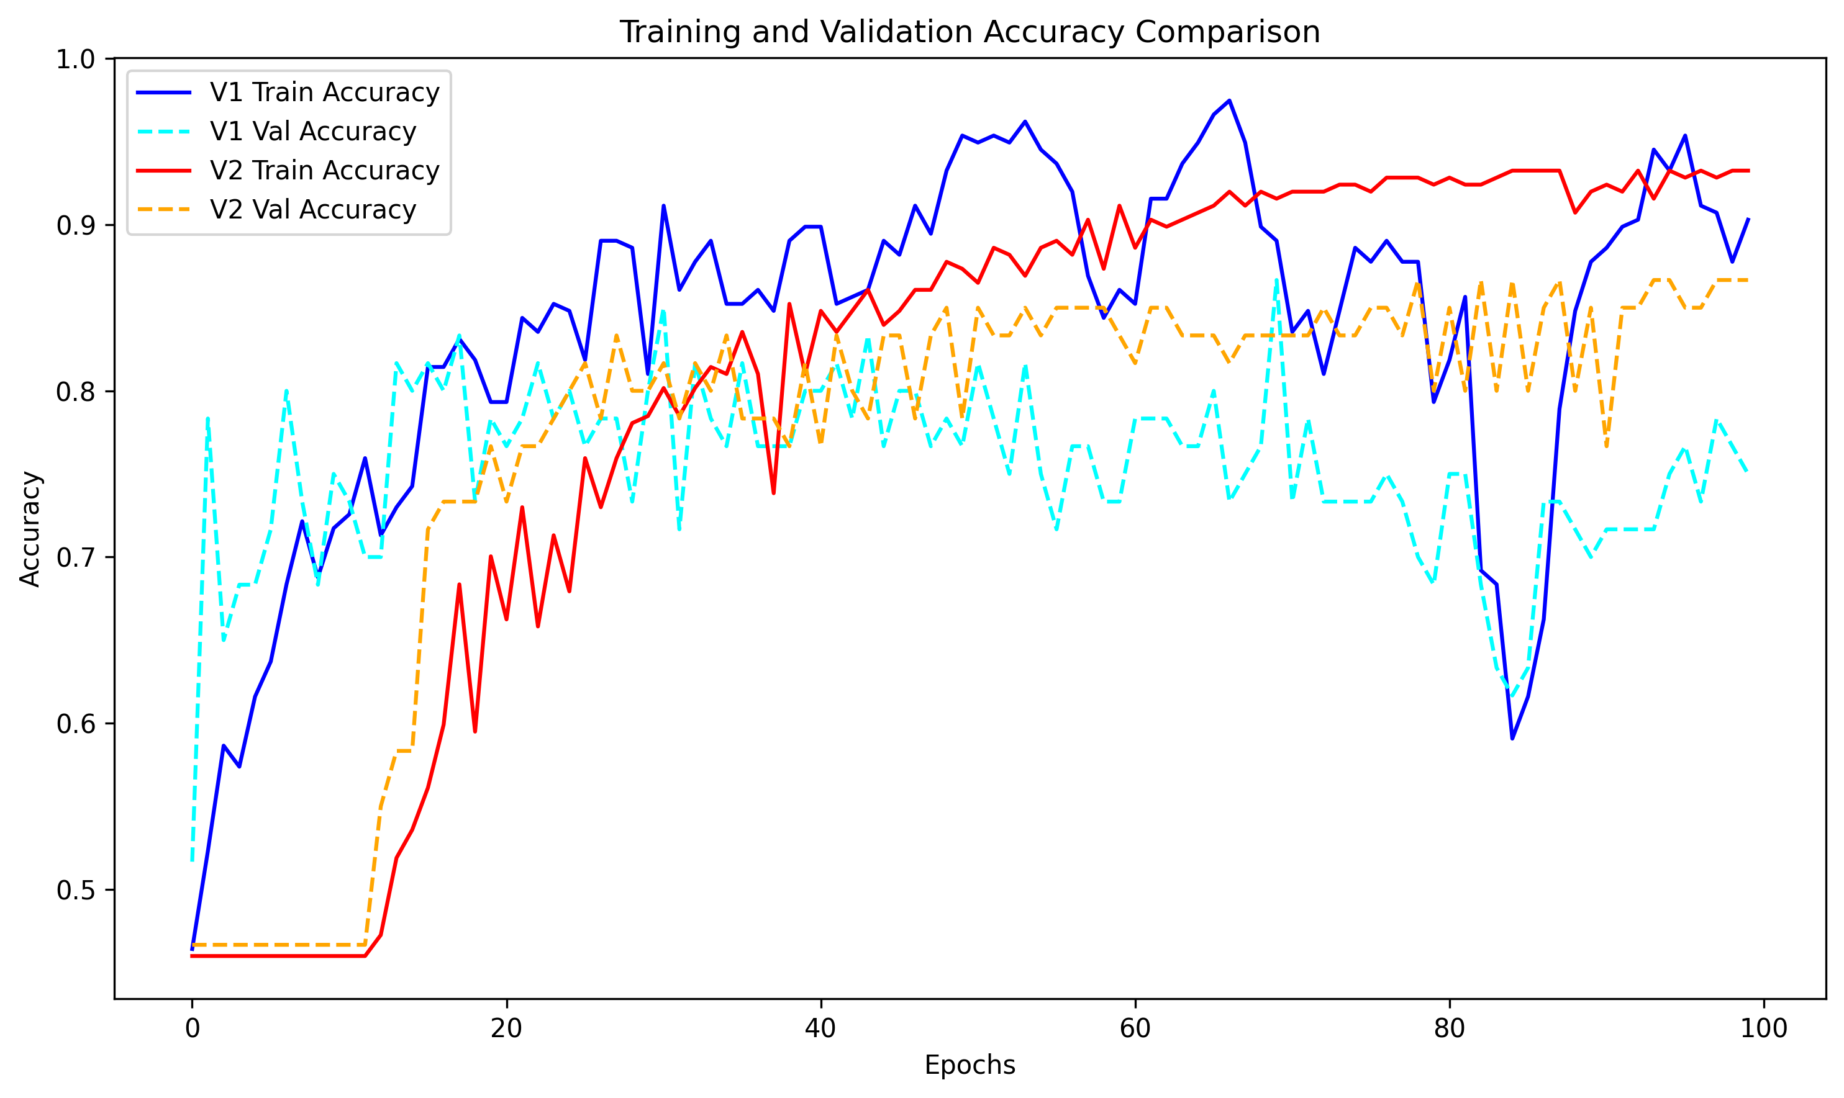
Accuracy Curve

Slide 16
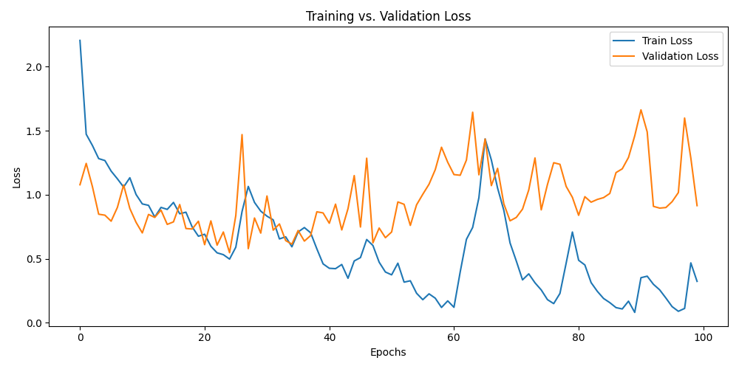
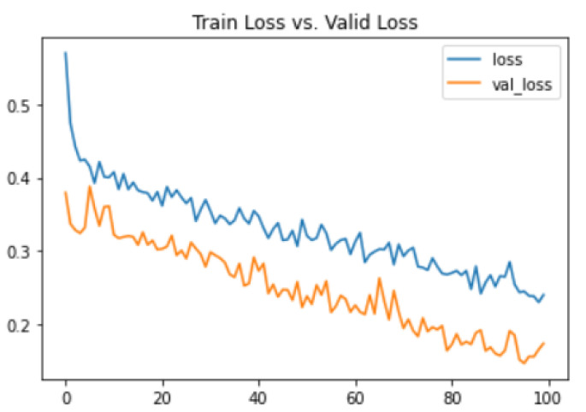
Loss Curve (Author’s approach)
10.3390/biomedicines10112796

Slide 17
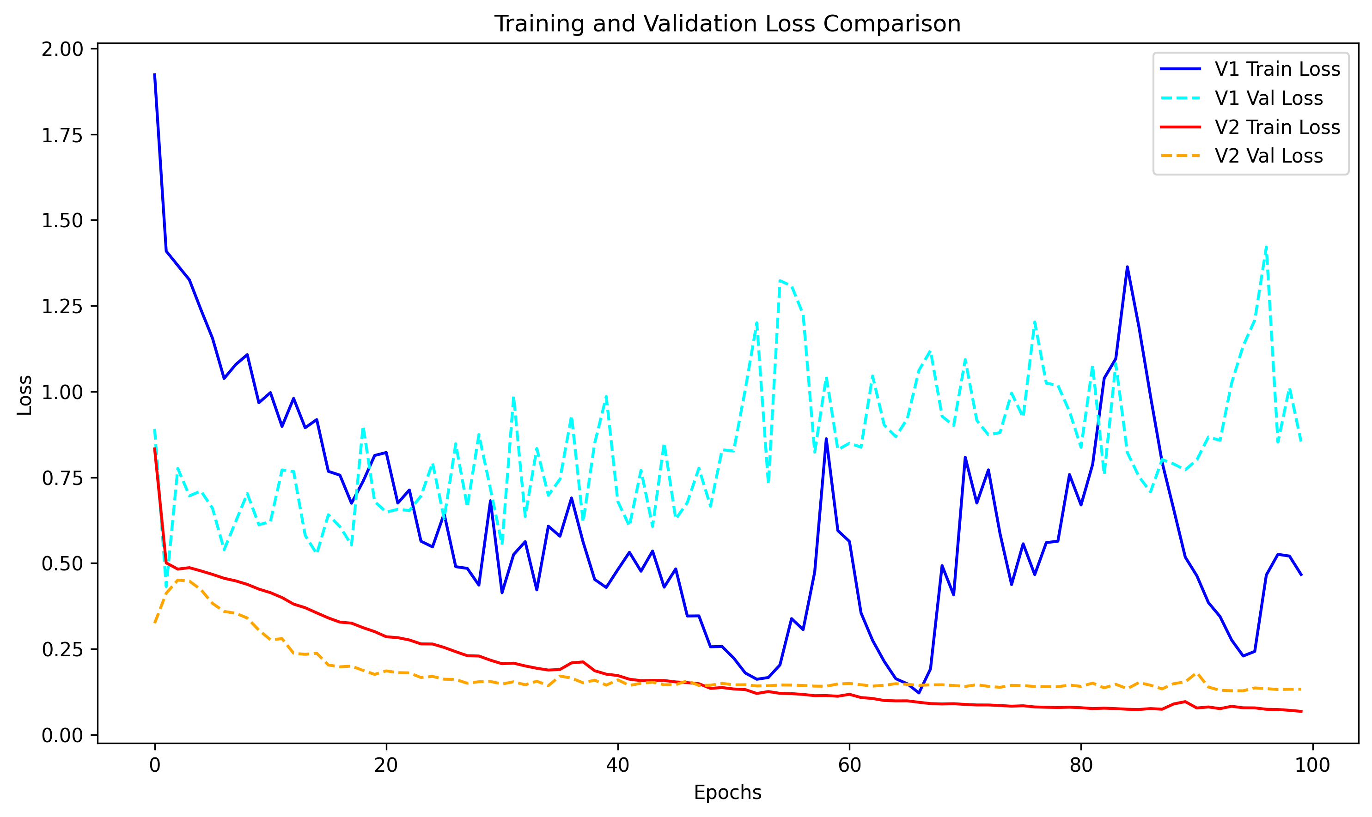
Loss Curve

Slide 18
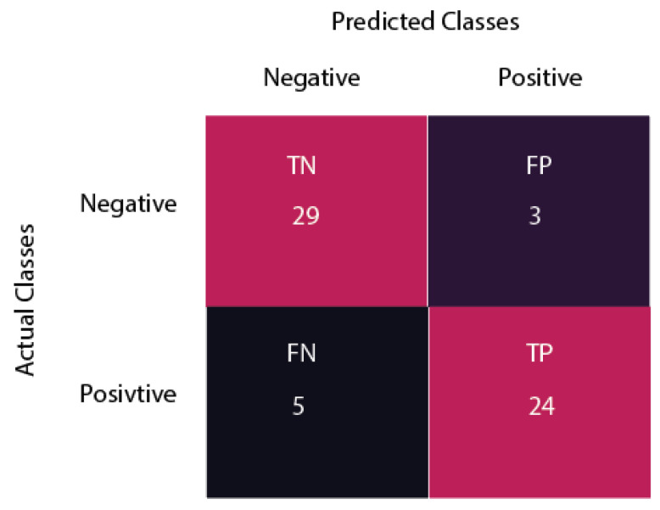
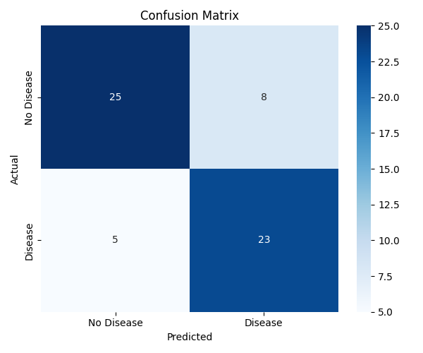
Confusion matrix
10.3390/biomedicines10112796

Slide 19
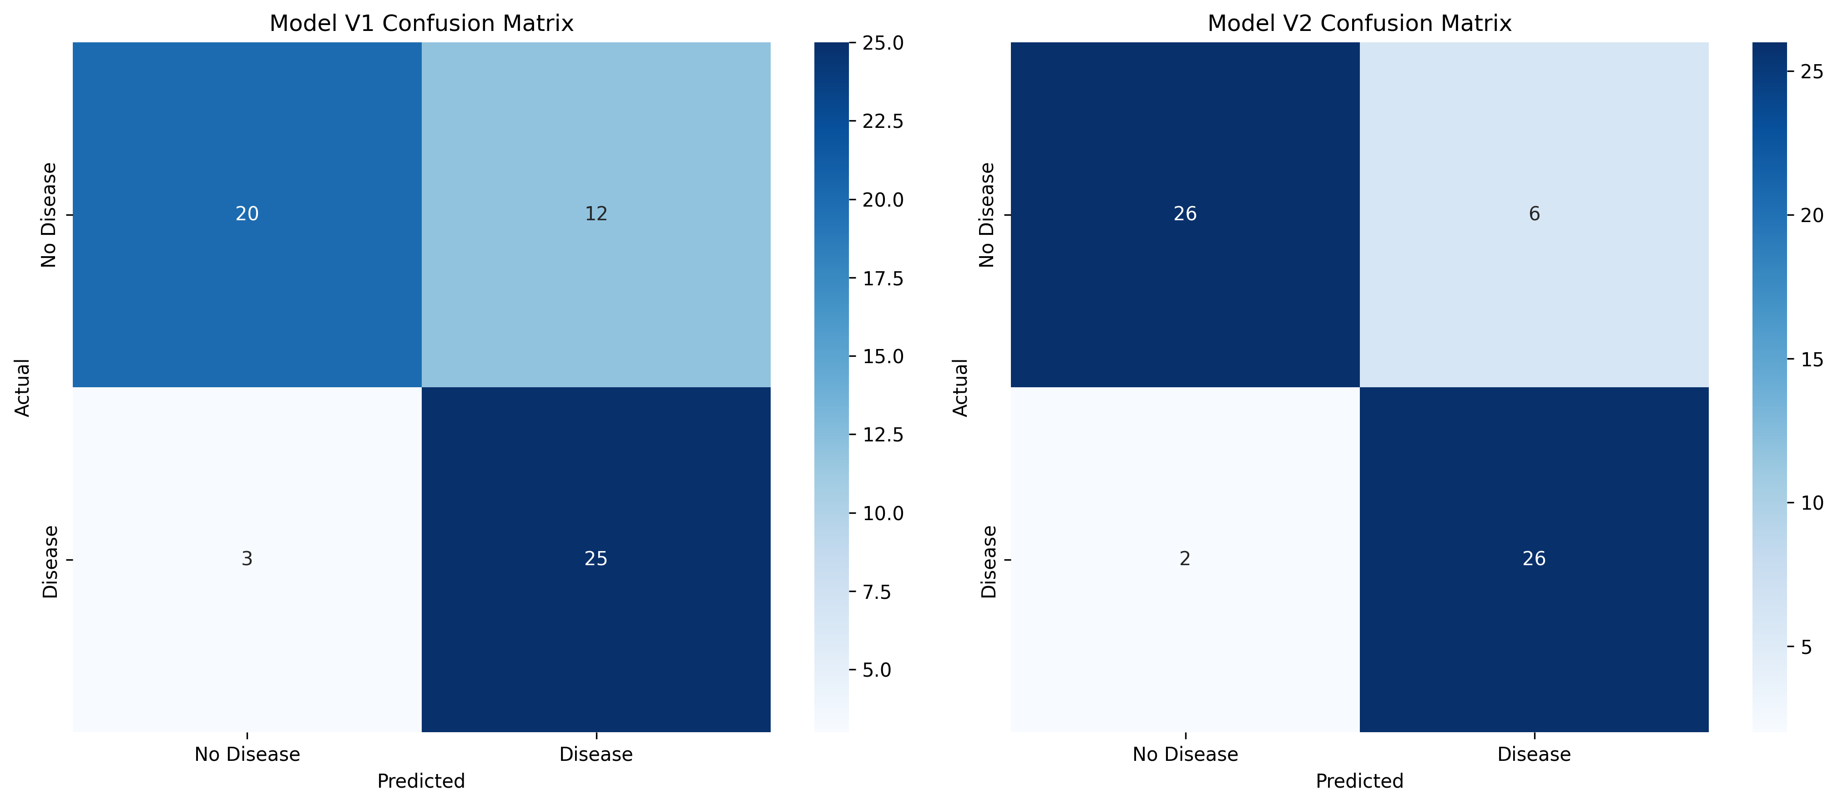
Confusion matrix

Slide 20
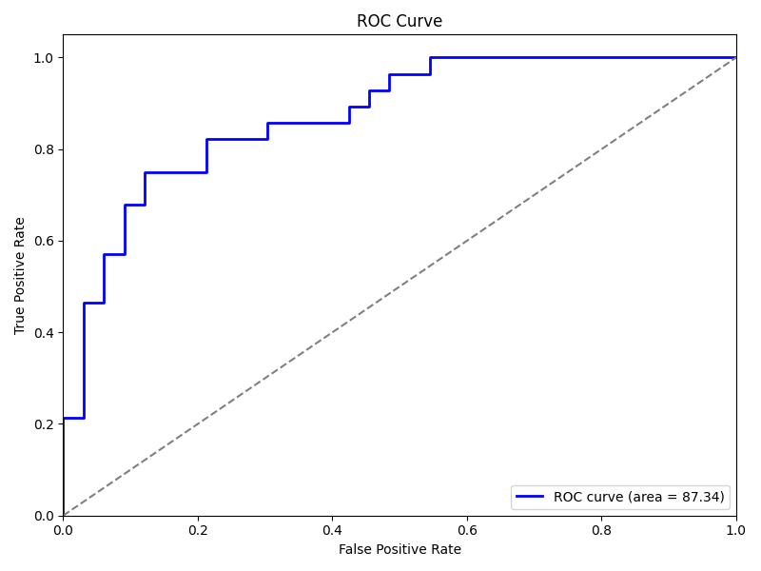
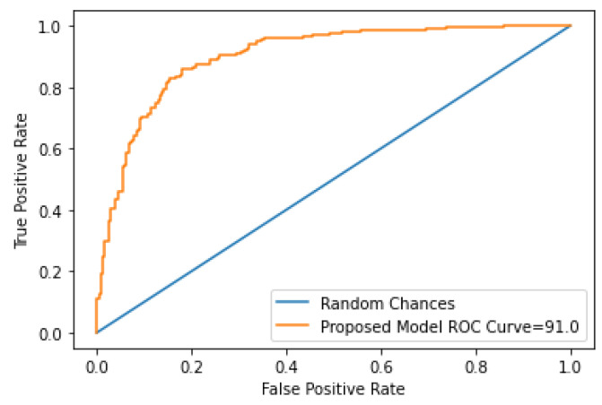
ROC Curve (Author’s approach)
10.3390/biomedicines10112796

Slide 21
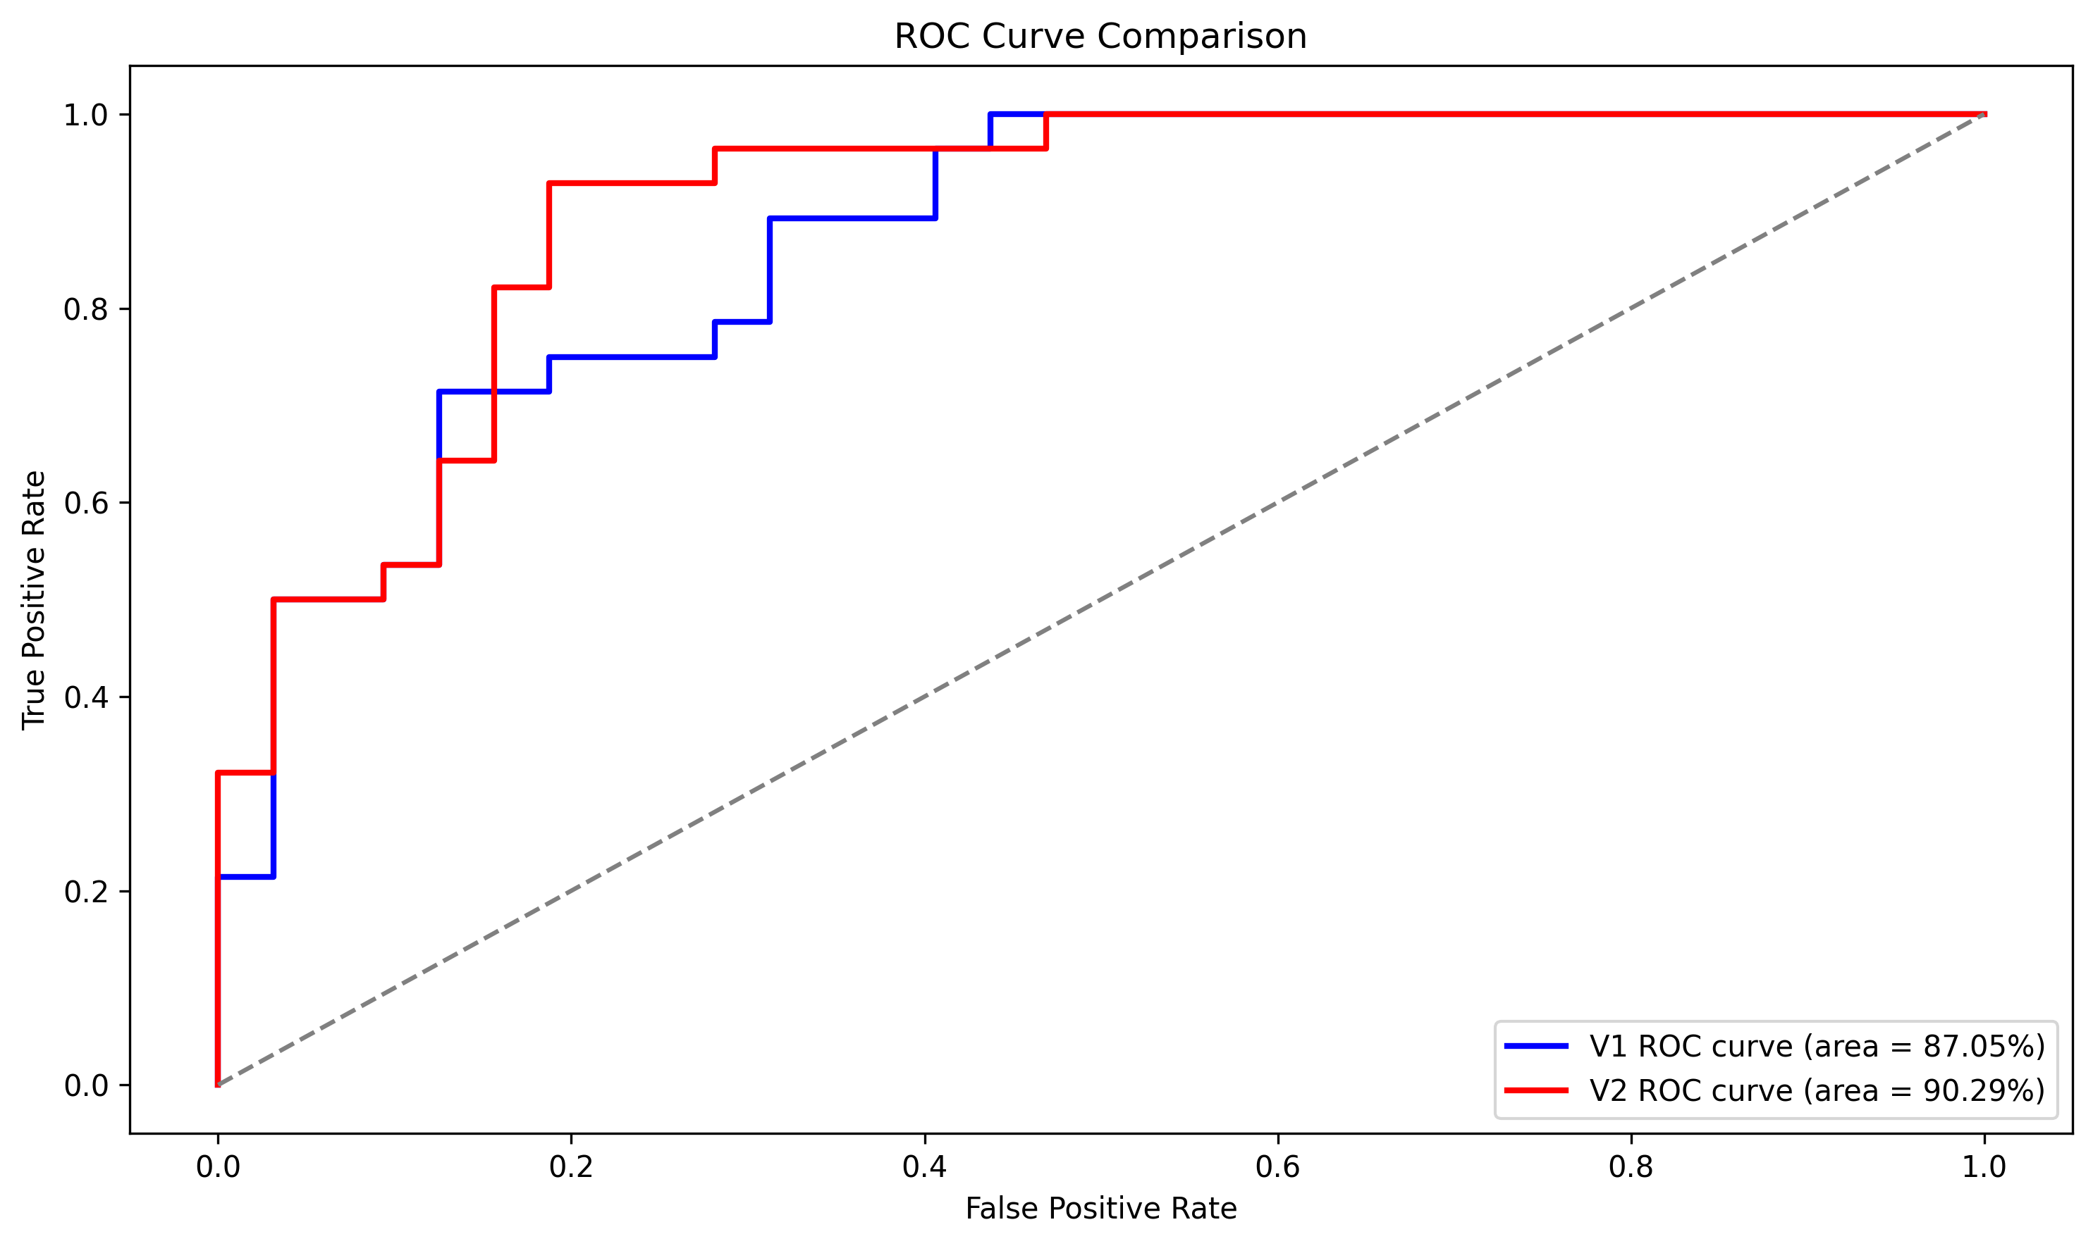
ROC Curve

Slide 22
Exploring IMAGE-Based Classification USING CNN
Heart Disease data set is of the form of 1D (N features rows), while CNNs has been proven way better for images which are 2D pixels arrays. (Reference: https://arxiv.org/abs/2106.03253)
Usually, tabular data sets are way more non-uniform compared to pixels which are uniform as they will lie in certain numeric range (1-255).

Slide 23
MRI-based brain tumor detection using convolutional deep learning methods and chosen machine learning techniques
Goal:
Using magnetic resonance brain images to enable physicians to detect with high accuracy tumors in early stages.
How the Paper reached the Goal:
A dataset containing 3264 Magnetic Resonance Imaging (MRI) brain images comprising images of glioma, meningioma, pituitary gland tumors, and healthy brains.
Developed and trained a new 2D Convolutional Neural Network (CNN) network to predict these 4 classes of tumors and achieved more than 90% validation accuracy.

Slide 24
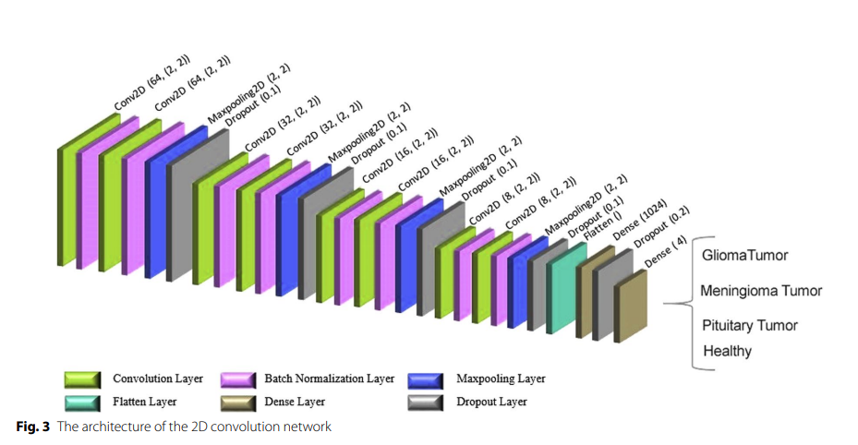
MODEL Architecture (2D CNN RPM Model)
Model Dynamics
90-10 split between training and testing
Used ReLU activation function between inner layers
Classfication is done by last dense neuron layer with Softmax activation function.
Sparse Categorical Crossentropy for loss estimates

Slide 25
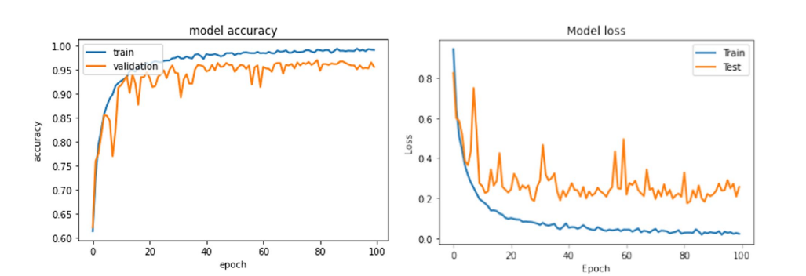
Results (Author):

Slide 26
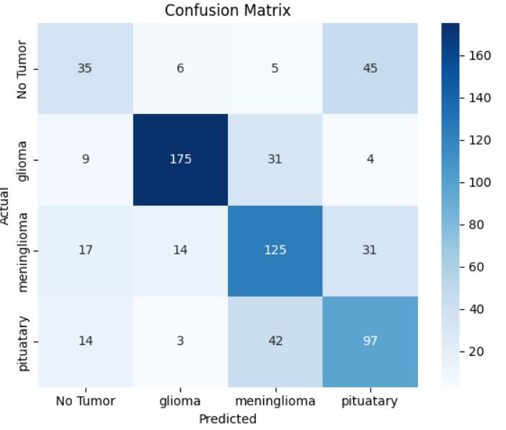
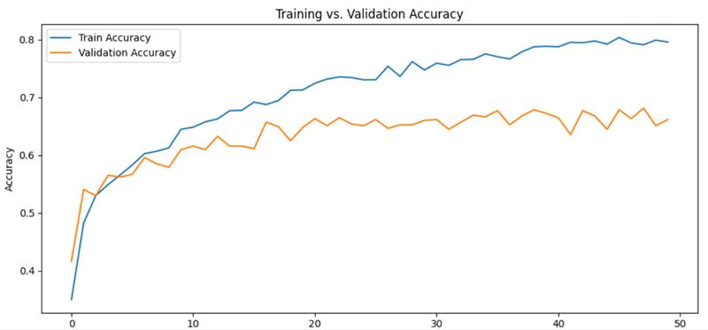
ConFusion Matrix and ACCURacy Curves

Slide 27
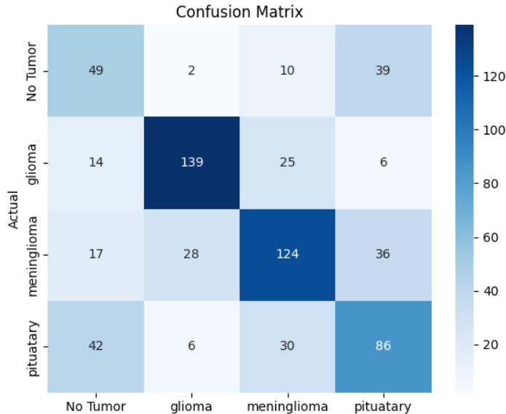
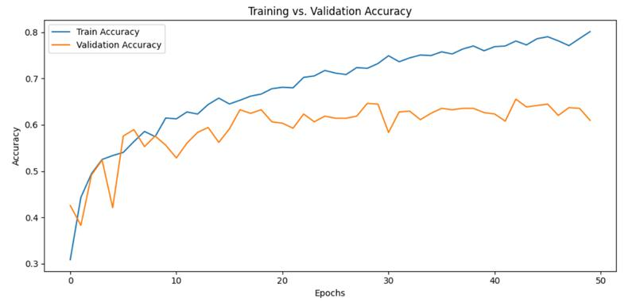
Introducing Class Weights
Training set had less healthy cases (~300) compared to tumor cases (~2000).
Added class weights to set priority to the healthy case which is not presented well in the training set.

Slide 28
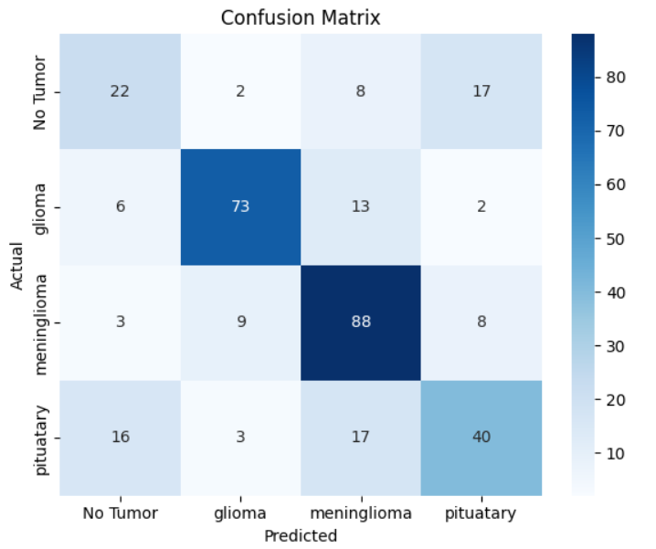
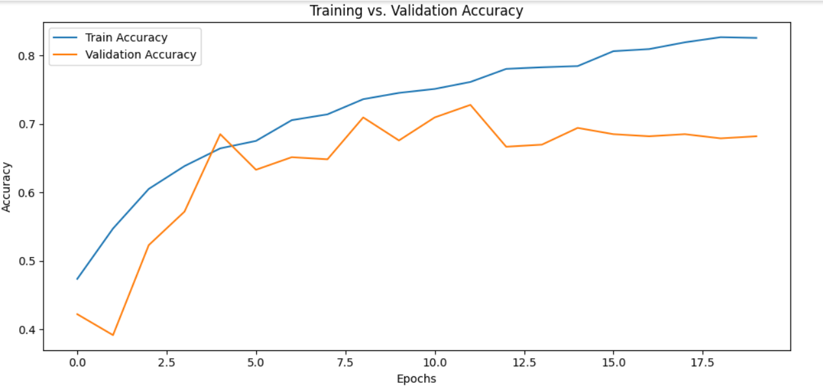
ReDucing Model ComplexITy (Reducing Overfitting)
Removed the 64 Neuron layer as we have a smaller data set compared to authors.

Slide 29
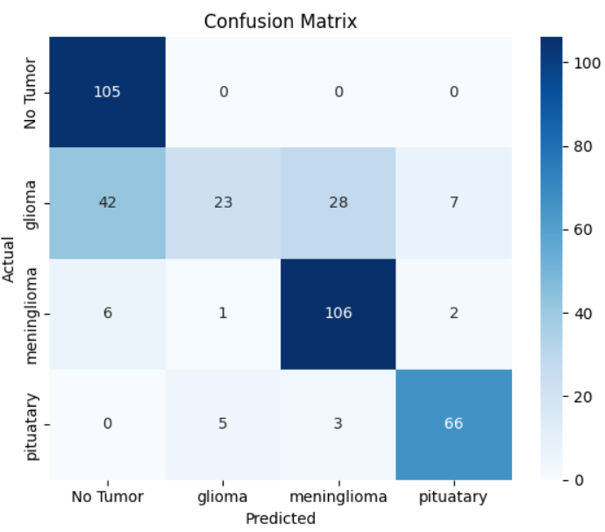
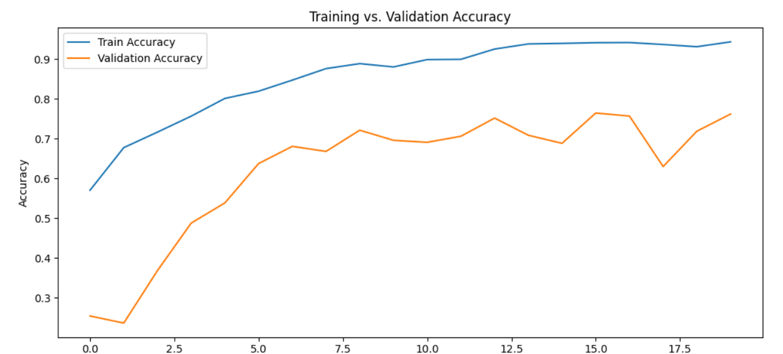
Using 1D CNN (BMK MODEL) on MRI Images

Slide 30
Limitations (Computational)
Training and validating 3000 (80 * 80 pixels) images needs GPU power (study used: 1 × Tesla K80, compute 3.7, having 2496 CUDA cores, 12 GB GDDR5 VRAM). Each run took around 30 mins on our available resources for 50 epochs.
With low computational power, extremely hard to apply data augmentation as done in the literature, where they rotated and vertically flipped each image to get a complete training and testing data sets containing 9000 + images.
Large number of parameter space combinations possible and finding the ideal space is relatively tricky.

Slide 31
FUTURE WORK
Get good GPUs and try out data augmentation. Rotating 90 both clockwise and anti-clockwise, with vertical flipping (12000 images data set)
Work on reducing overfitting. While data augmentation might help, we'll try changing the parameter space mainly filter sizes, learning rates, batch sizes and drop-out values.
Trying our model on detecting tumors in lungs and liver working with X-ray images, hoping to help someone in need.

Slide 32
THANK YOU
QUESTIONS

